Slide 1
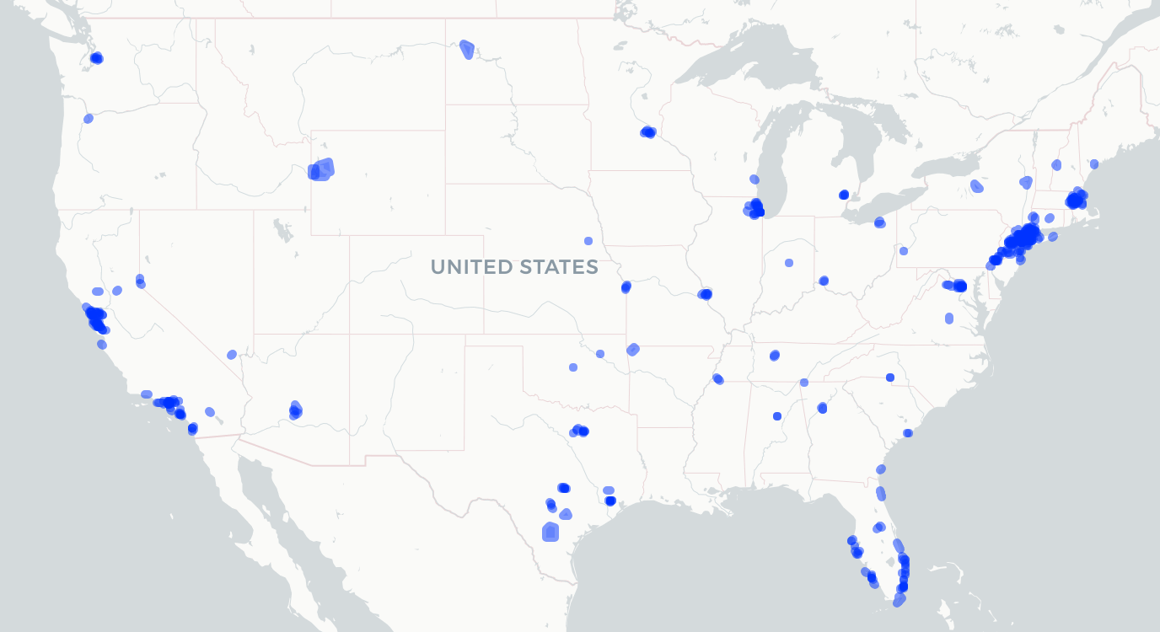
Assignment
Create visualization from wealthy zips (data on the drive)
Add polygon (please find the syntax by googling it!)
Add label by the mean income
Accessing mean income by wealthy_zips@data$mean_income

